Slide 1



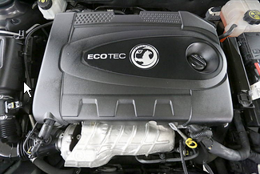
In Partnership with AA Warranty Mechanical Breakdown Insurance Gold Cover
Designed For Your Car
Your Personalised Plan
Key Benefits
Added Protection
Peace of Mind
My Options and Costs
Key Features of Your Chosen Vehicle:
Your Personalised Cover Includes:
ADD AS NOW in black writing with Green ticks
ADD AS NOW in black writing with Green ticks

Slide 2

In Partnership with AA Warranty Mechanical Breakdown Insurance Gold Cover
Designed For Your Car
Your Personalised Plan
Key Benefits
Added Protection
Peace of Mind
My Options and Costs
Did you know …
40% of cars breakdown after expiry of the manufactures warranty at least once
The UK has a £200 million annual breakdown repair bill paid out by warranty companies
Labour rates for an auto electrician alone could cost up to £200 per hour. The average bill in the UK on AA MBA Warranty pay out is £715
Up to 5.2 million drivers can’t afford the repair bill
All listed mechanical and electrical components are covered as per the manufacturers original specification
No mileage limitations - so you don’t need to worry if you have a fault with the vehicle
The warranty gives you unlimited number of claims on aggregate up to the retail value of the vehicle
60 days European cover when travelling outside of the UK

Slide 3
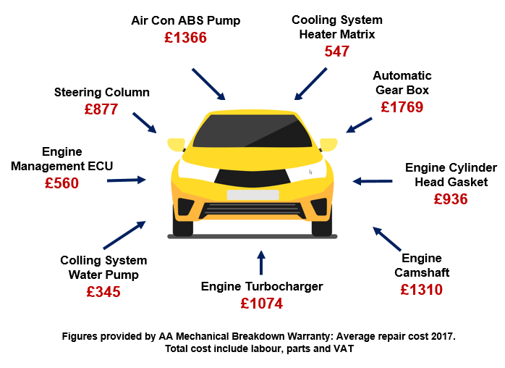
In Partnership with AA Warranty Mechanical Breakdown Insurance Gold Cover
Designed For Your Car
Your Personalised Plan
Key Benefits
Added Protection
Peace of Mind
My Options and Costs
Car Ownership shouldn’t be Stressful
Average Cost of Repair
Examples of claims paid in the last 3 months
With cars becoming increasingly electrical even your most common fault may have to be diagnosed by a specialist technician.
These technological developments mean that cars now require more specialist attention which may not be able to be handled by your own mechanic.
Ford Focus
Reg: MW62 RXP
Part: Manual Gearbox/ Engine
Management Reprogramming
£3954.23

Slide 4


In Partnership with AA Warranty Mechanical Breakdown Insurance Gold Cover
Designed For Your Car
Your Personalised Plan
Key Benefits
Added Protection
Peace of Mind
My Options and Costs
Stop worrying about unexpected car repair bills…
After our house, our car is the second biggest purchase we make in our lifetime, so it’s the sensible choice to make sure you are covered with Mechanical Breakdown Insurance
Hassle FREE car ownership

Slide 5


In Partnership with AA Warranty Mechanical Breakdown Insurance Gold Cover
Designed For Your Car
Your Personalised Plan
Key Benefits
Peace of Mind
Added Protection
My Options and Costs
Decide your AA Warranty Gold Cover Term
1 Year
2 Years
3 Years
Yes, I would like to go ahead with X year
AA Warrant Gold Cover Protection
Weekly : XXX
Total : XXX
Policy Commences at expiry of manufacturers Warranty. Subject to mileage restrictions this will be on: XX/XX/XXXX
I understand that the vehicle will not have any warranty and I would like to proceed without it
Sales Advisor: Joe Bloggs

